Slide 1

WIPRO NGA Program – 25SUB4507_NMS Developer
Capstone Project Presentation – 16th Feb & 17th Feb 2026
CRUD operations with RESTCONF and JAVA
Presented by – G3
Shiven Chauhan (56198)
Saransh Sharma (56199)
Jai Anshul Gautam (56186)
Chhavi Gupta (57181)
Vicky Jha (56207)
Shubham Kumar Mehta (56232)
Nallavelly Lalith Reddy (56217)
Priyanshu Dagar (56197)
www.rpsconsulting.in

Slide 2

Project Overview
Enterprise backend system built using Spring Boot
Implements full CRUD operations on network devices
Role-Based Access Control (ADMIN / USER) enforced
MySQL integrated for persistent storage
2024 - RPS Consulting all rights reserved

Slide 3
Problem Statement
Develop a Java application to implement RESTCONF-based CRUD operations over HTTP, enabling creation, retrieval, modification, and deletion of network configuration resources with proper response handling and API validation.
2024 - RPS Consulting all rights reserved

Slide 4
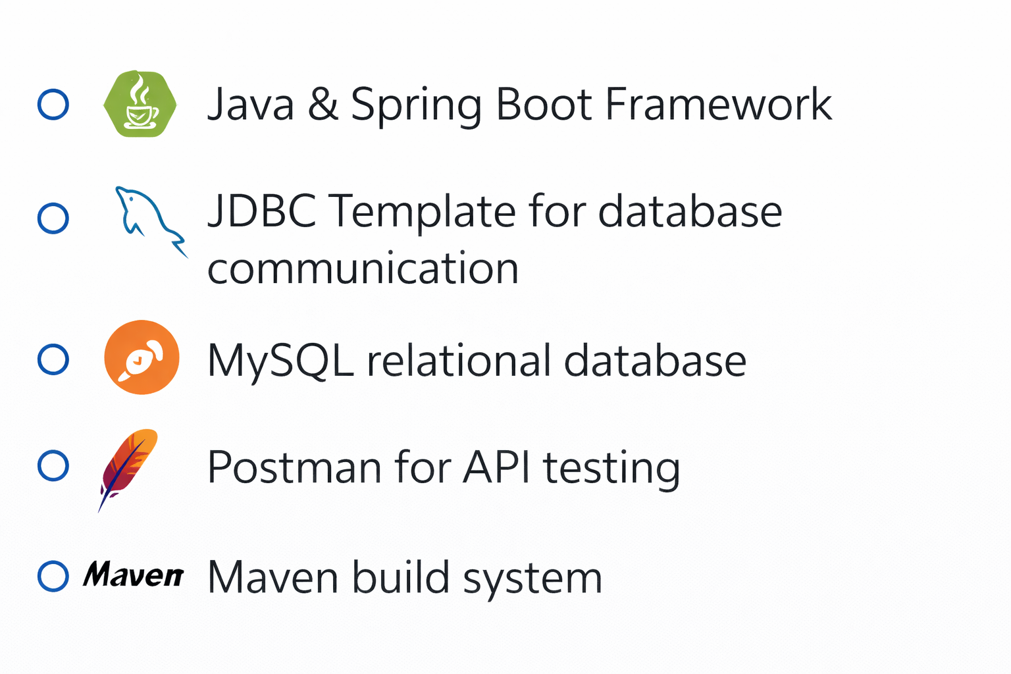
Technology Stack
2024 - RPS Consulting all rights reserved

Slide 5
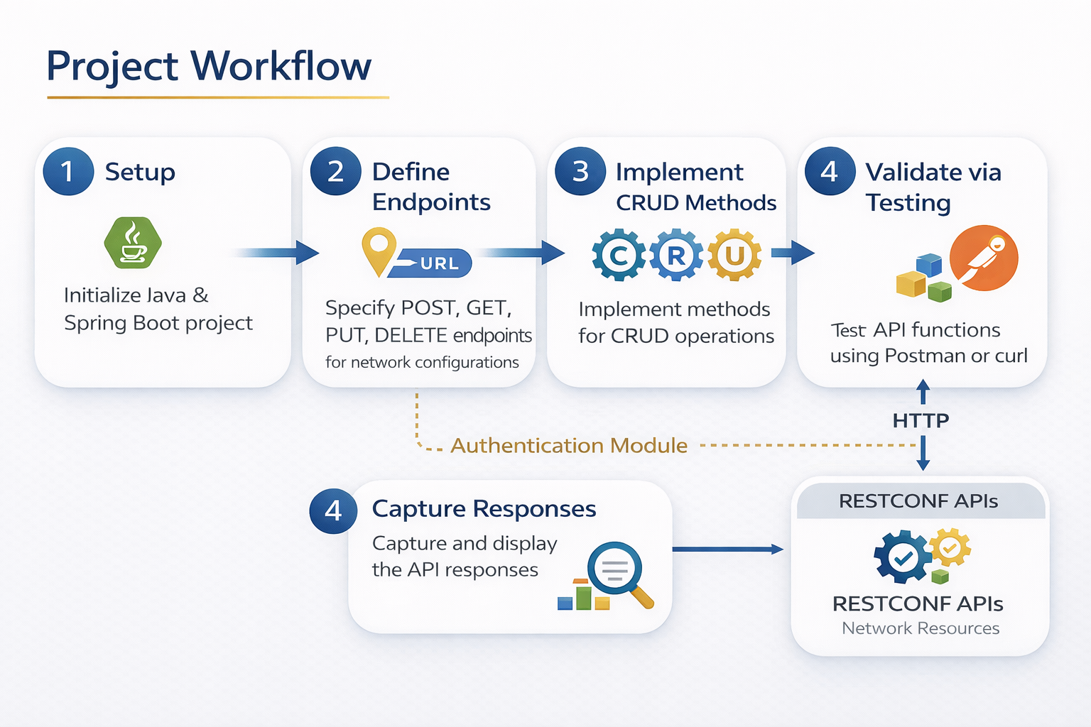
2024 - RPS Consulting all rights reserved

Slide 6
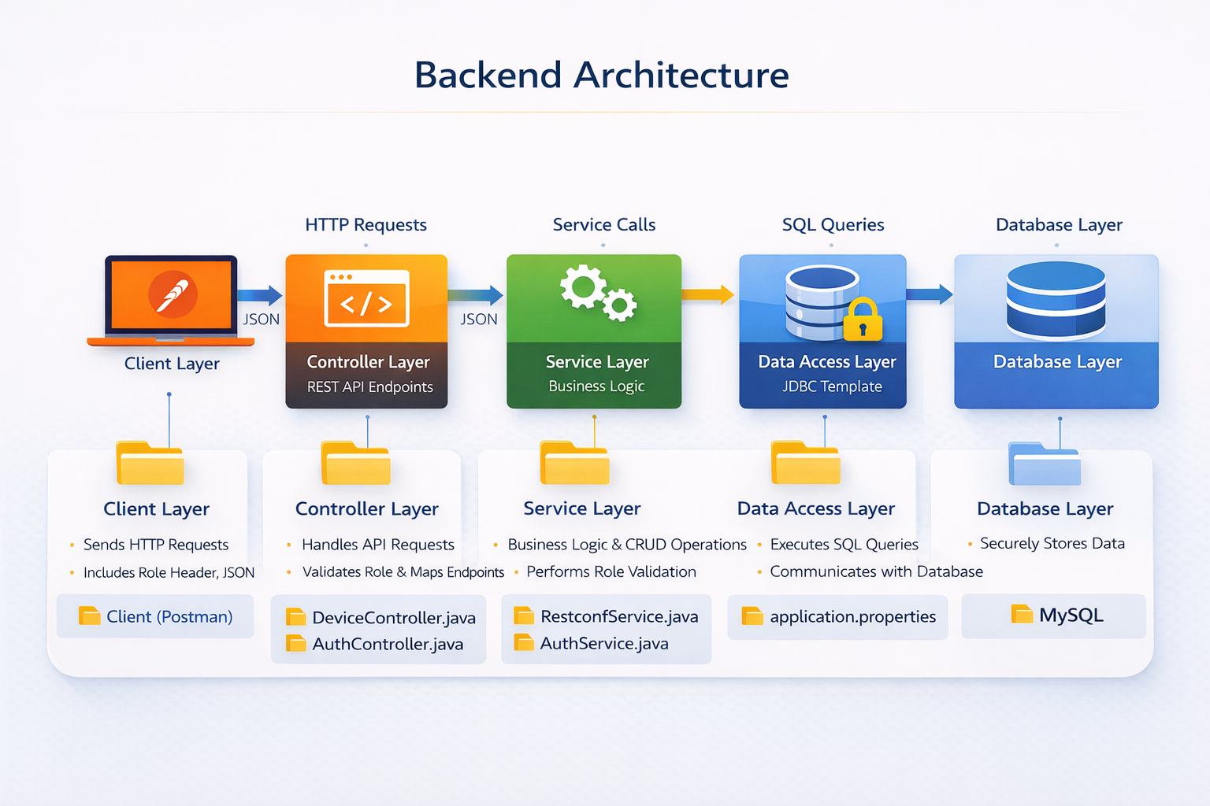
2024 - RPS Consulting all rights reserved

Slide 7
Authentication Module
Secure Login & Role Validation
2024 - RPS Consulting all rights reserved

Slide 8
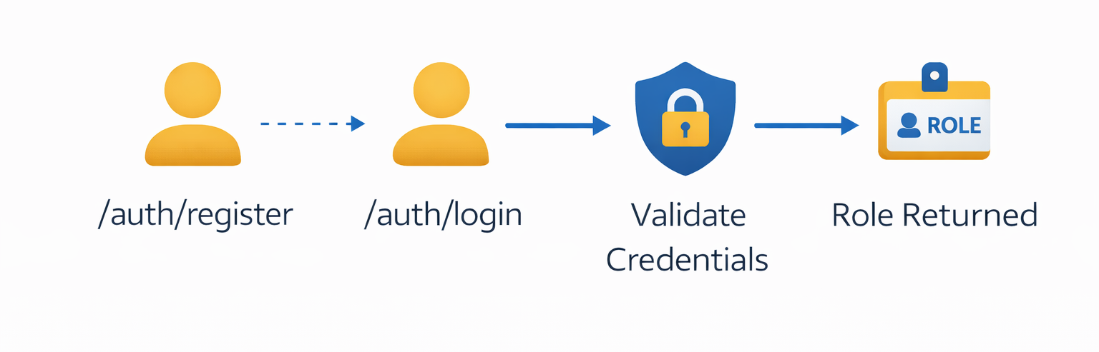
Authentication Flow
User registers via /auth/register
User logs in via /auth/login
System validates credentials
Role returned to client
2024 - RPS Consulting all rights reserved

Slide 9
AuthController.java
Maps Authentication Endpoints
Defines REST API routes such as /auth/register and /auth/login to handle user authentication requests.
Accepts JSON Request Body
Receives user data (username, password, role) in JSON format using @RequestBody.
Calls AuthService Methods
Delegates business logic and credential validation to the AuthService layer.
Returns Response to Client
Sends authentication result (success message or role) back to the client as an HTTP response.
2024 - RPS Consulting all rights reserved

Slide 10
AuthService.java
Executes SQL Queries using JDBC Template
Interacts with the MySQL database to retrieve and store user data.
Validates Username and Password
Checks whether the provided credentials match the records in the database.
Returns User Role
Fetches and returns the assigned role (ADMIN / USER) after successful authentication.
Handles Authentication Logic
Implements the core business logic for user registration and login processes.
2024 - RPS Consulting all rights reserved

Slide 11
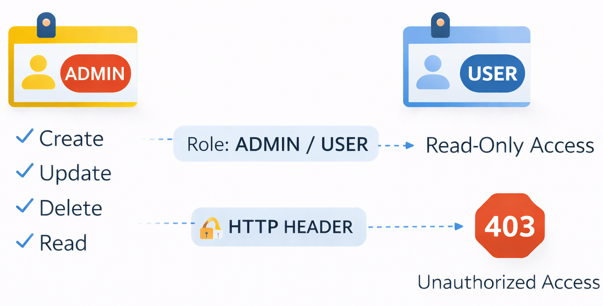
Role Based Access Control
2024 - RPS Consulting all rights reserved

Slide 12
Device Management
CRUD Implementation
2024 - RPS Consulting all rights reserved

Slide 13
DeviceController.java
Maps POST, GET, PUT, DELETE Endpoints
Defines REST API routes for handling CRUD operations.
Validates Role Before Execution
Checks the user’s role (ADMIN / USER) before allowing access to restricted operations.
Delegates Logic to Service Layer
Forwards requests to the service layer where business logic is implemented
2024 - RPS Consulting all rights reserved

Slide 14
RestconfService.java
Contains create(), read(), update(), delete()
Implements core CRUD methods for managing device records.
Executes SQL Queries
Uses JdbcTemplate to perform database operations.
Ensures Data Persistence
Stores and retrieves data reliably from the MySQL database.
2024 - RPS Consulting all rights reserved

Slide 15
Database Configuration
Configured in application.properties
Database connection settings are defined in the Spring Boot configuration file.
Datasource URL, Username, Password
Specifies the database URL and credentials required for connection.
MySQL JDBC Driver Configured
Uses the MySQL JDBC driver to enable communication between the application and the database.
2024 - RPS Consulting all rights reserved

Slide 16
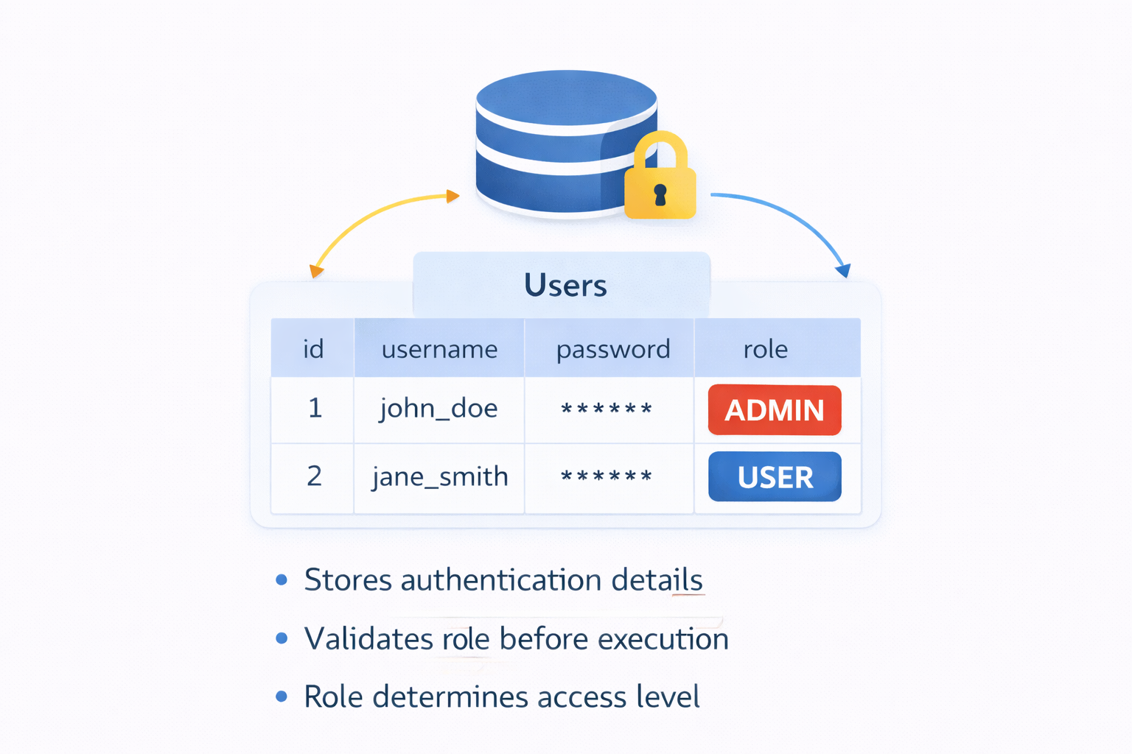
Users Table Schema
2024 - RPS Consulting all rights reserved

Slide 17
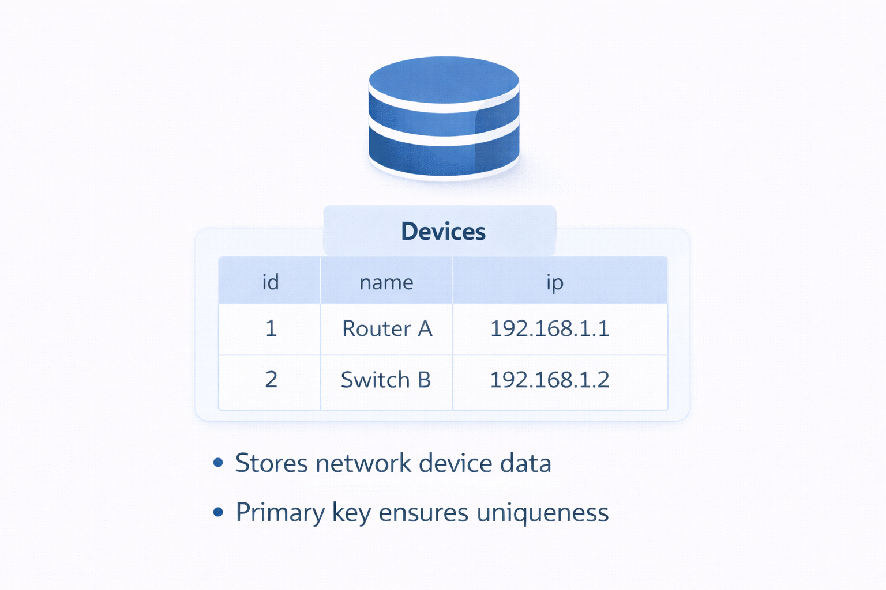
Device Table Schema
2024 - RPS Consulting all rights reserved

Slide 18
CRUD OPERATIONS
API Execution & Validation
2024 - RPS Consulting all rights reserved

Slide 19
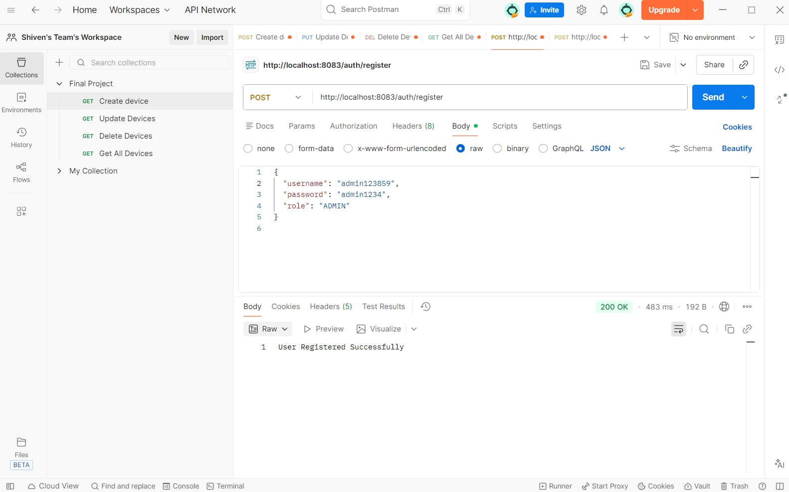
CREATE Operation – POST (User)
2024 - RPS Consulting all rights reserved

Slide 20
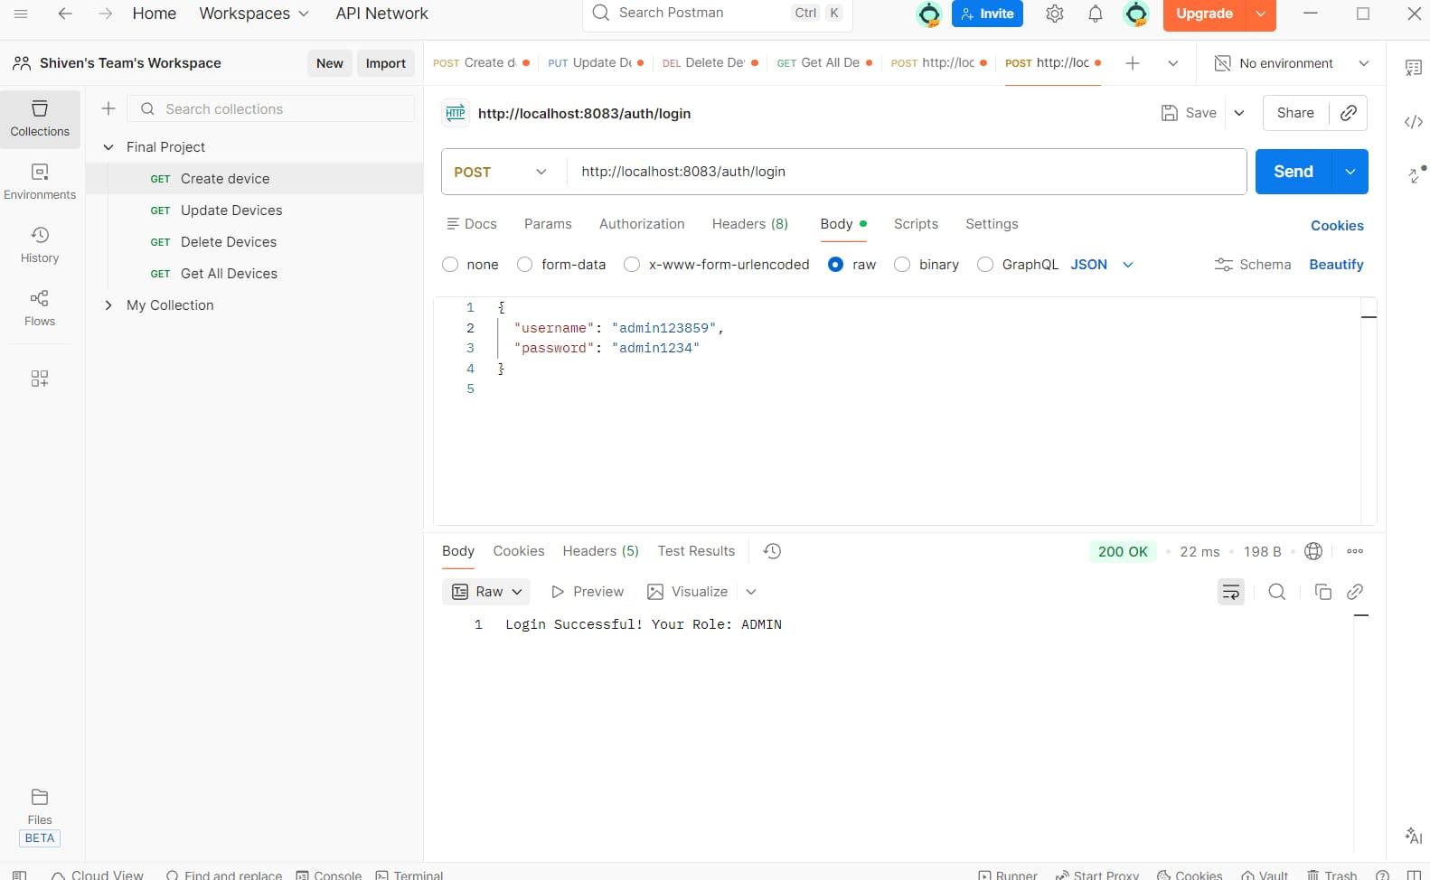
CREATE Operation – POST (User)
2024 - RPS Consulting all rights reserved

Slide 21
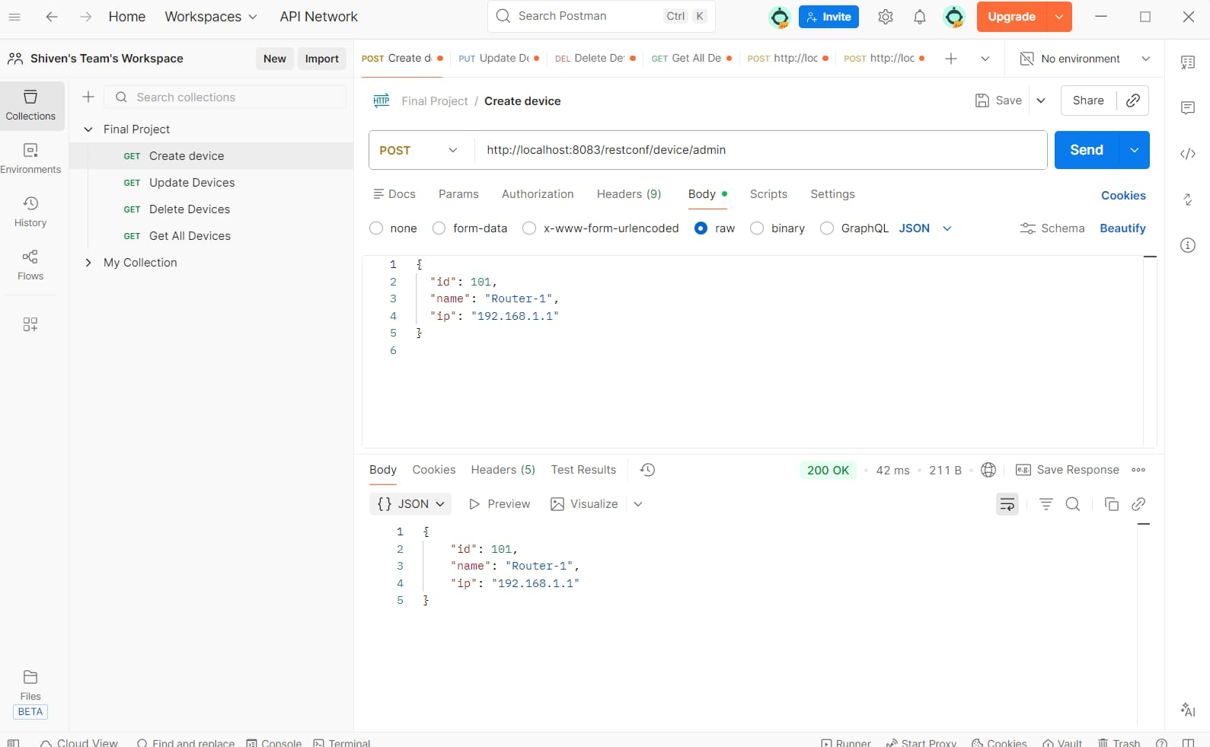
CREATE Operation – POST (Device)
2024 - RPS Consulting all rights reserved

Slide 22
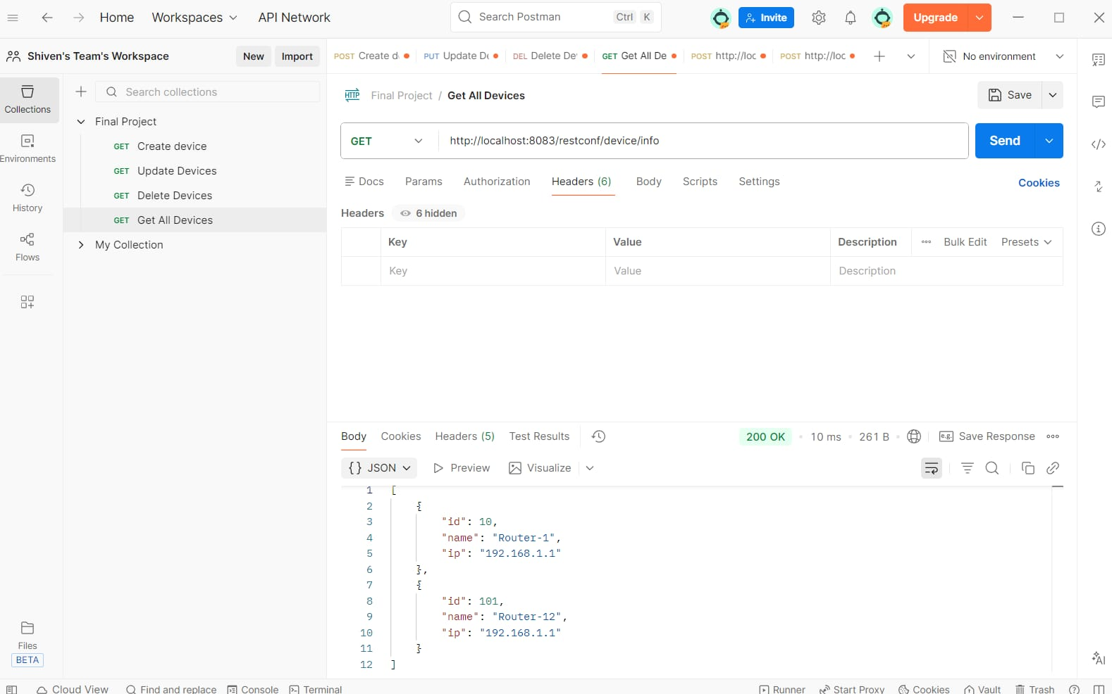
READ Operation – GET
2024 - RPS Consulting all rights reserved

Slide 23
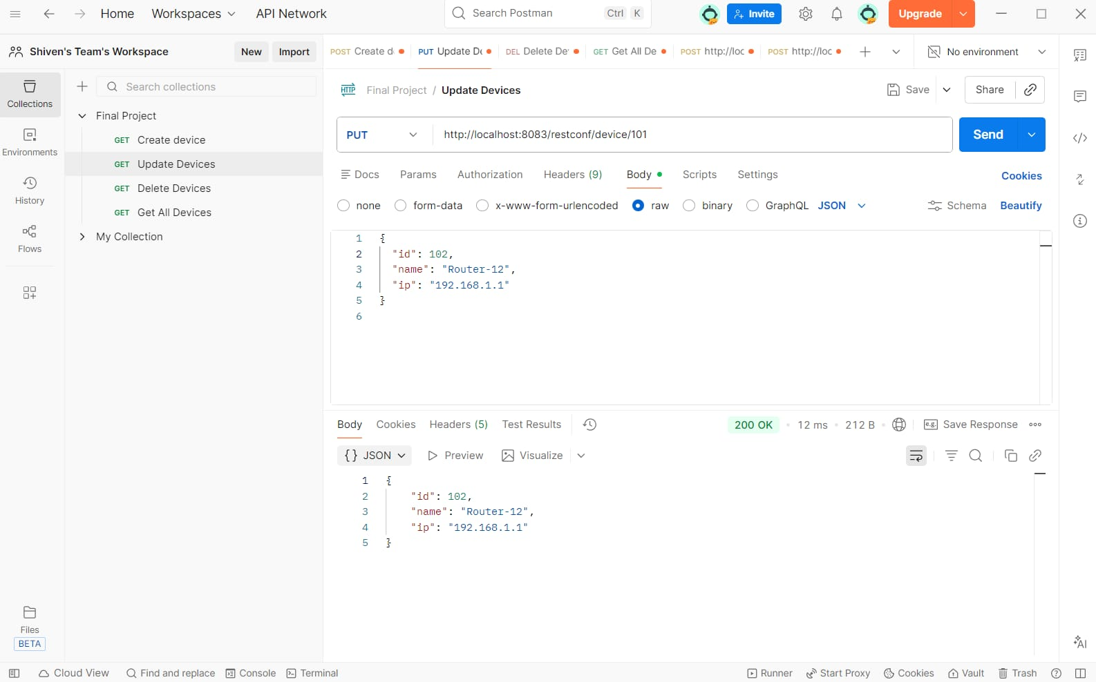
UPDATE Operation – PUT
2024 - RPS Consulting all rights reserved

Slide 24
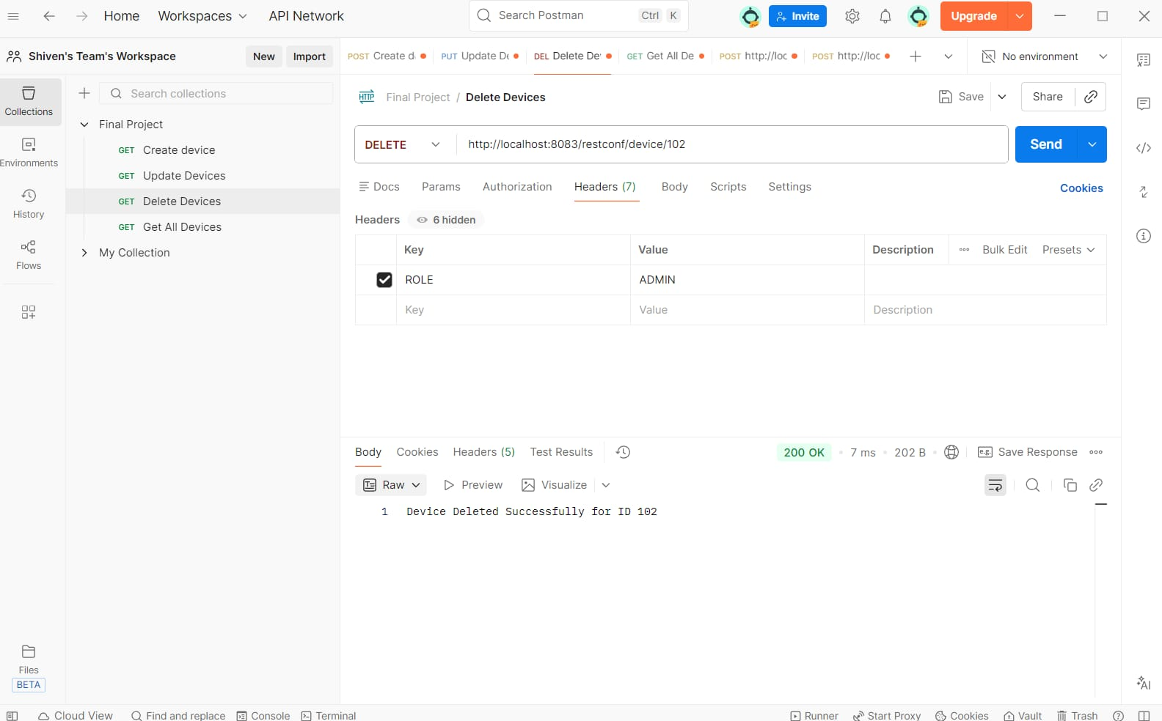
DELETE Operation – DELETE
2024 - RPS Consulting all rights reserved

Slide 25
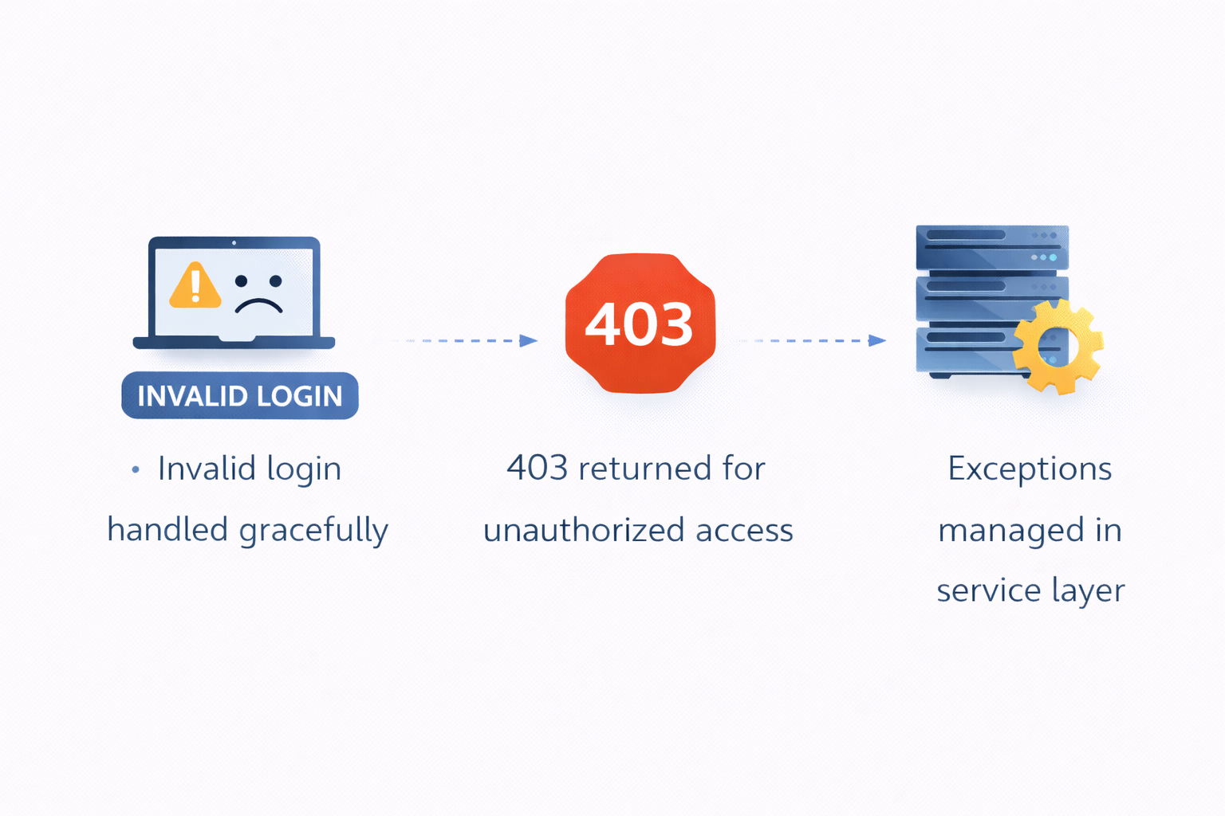
Error Handling
2024 - RPS Consulting all rights reserved

Slide 26
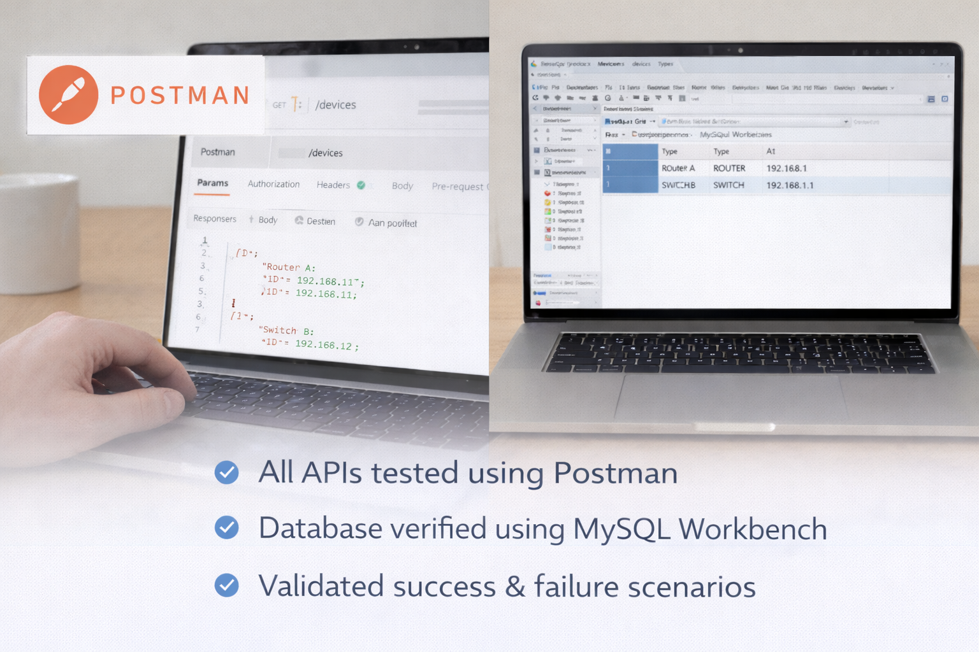
Testing & Validation
2024 - RPS Consulting all rights reserved

Slide 27
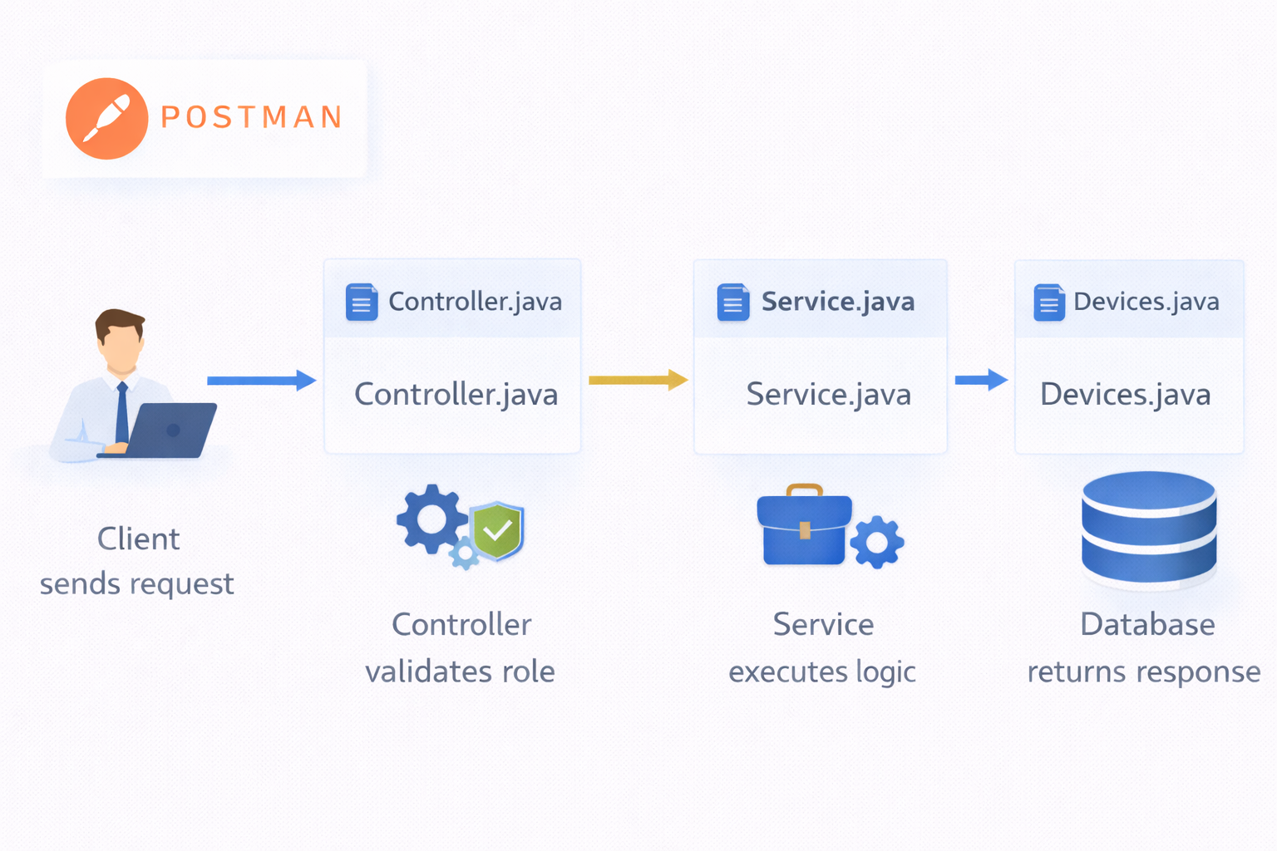
Sequence Flow Overview
2024 - RPS Consulting all rights reserved

Slide 28
Project Achievements
Secure CRUD Backend Implemented
Successfully developed REST APIs with complete Create, Read, Update, and Delete operations.
RBAC Successfully Enforced
Role-Based Access Control ensures authorized access for ADMIN and USER roles.
Enterprise-Level Architecture Achieved
Designed using layered architecture principles for scalability, security, and maintainability.
2024 - RPS Consulting all rights reserved

Slide 29
Future Enhancements
JWT-based Authentication
Implements token-based security for stateless and secure API access.
Password Encryption (BCrypt)
Encrypts user passwords to enhance security and prevent plaintext storage.
Swagger Documentation
Provides interactive API documentation for easier testing and integration.
Cloud Deployment
Deploys the application on cloud platforms for scalability and real-world accessibility.
2024 - RPS Consulting all rights reserved

Slide 30
Conclusion
Demonstrates Modern Backend Development
Implements RESTful design principles using Spring Boot and structured layering.
Applies Security, Scalability & Clean Architecture
Ensures secure access control, modular design, and maintainable code structure.
Ready for Enterprise Deployment
Designed to meet real-world application standards and scalable production environments.
2024 - RPS Consulting all rights reserved

Slide 31
THANK YOU !
This concludes our presentation.
2024 - RPS Consulting all rights reserved

